Slide 1

06/13/2022
German E. Baltazar Reyes

Slide 2
Context
Several people fight with each other until one person survives.
People outside the event could place bets on who would survive.

Slide 3
Dataset
Titanic dataset
891 observations
69 features
Gives passengers information and if they survived the accident or not
Removed 96 repeated observations
Selected only 11 features
9 original
2 engineered (fam_size and classes)
Sex (boolean) | Age (int) | Survived (boolean)
Pclass_1 (boolean) | Pclass_2 (boolean) | Pclass_3 (boolean)
Fare (float) | Small family (boolean) | Large family (boolean)

Slide 4
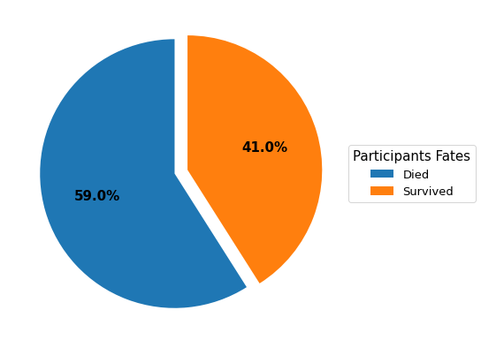
Justification
Difficult to guess the survivors

Slide 5
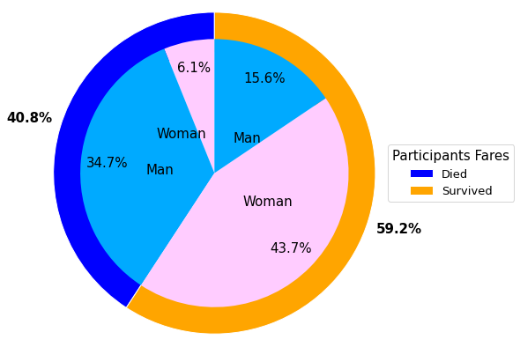
justification
Barely more than half of the money is invested on survivors
$16,227.38 bet on survivors
$11,962.57 women
$4,264.81 men
$11,173.85 bet on dead people
$1,674.94 women
$9,498.91 men

Slide 6
Objectives
Determine if a person can survive based on several factors
Simple Logistic Regression
Artificial Neural Networks
Binary classification
Predict the cost of its fare
Artificial Neural Networks
Regression

Slide 7
Classification task
Data
Logistic Regression
ANN
Inputs: Sex, Age, Class, and Family Size
Output: Survived
70/10/15 data distribution
Train set: 556
Validation set: 120
Test set: 119
Train model
Finetune epochs
Validate model
Finetune learning rate
Test model
Use best model for accuracy
Train model
Select architecture and activations
Validate model
Finetune learning rate and epochs
Test model
Use best model for accuracy

Slide 8
regression task
Data
ANN
Inputs: Sex, Age, Class, Family Size, and Survived
Output: Fare
70/10/15 data distribution
Train set: 556
Validation set: 120
Test set: 119
Train model
Select architecture and activations
Validate model
Finetune learning rate and epochs
Test model
Use best model for accuracy

Slide 9
classification results
 | Training Accuracy | Validation Accuracy | Test Accuracy
Logistic Regression | 79.67% | 79.16% | 76.47%
ANN | 60.25% | 54.16% | 57.98%

Slide 10
regression results
 | Training R² | Validation R² | Test R²
ANN | 0.001554 | -0.00082 | -0.00386

Slide 11
Conclusions
More data is required
ANN is to complex for such little data
classification is an easier task
prediction of fares is non-linear
difficult to predict with little information

Slide 12
Thank you
Any questions?

Slide 13
appendix
Real-world use case 14
Survival analysis 15
Fare analysis 19
Engineered features 20
SLR model 21
ANN model for classification 24
Classification models comparison 27
ANN model for regression 28
Regression model results 31
Modification of ANN class 32

Slide 14
Real-world use case
Risk analysis for tourists and people in general, so healthcare programs could determine how prone a person is to die in a particular case (boarding a ship in this case).
For the person, he can determine how much money should receive for that particular coverage.

Slide 15
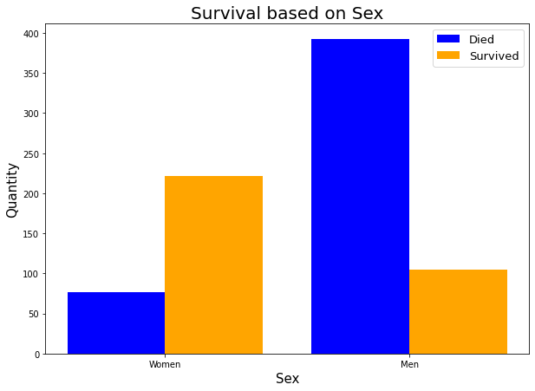
survival analysis

Slide 16
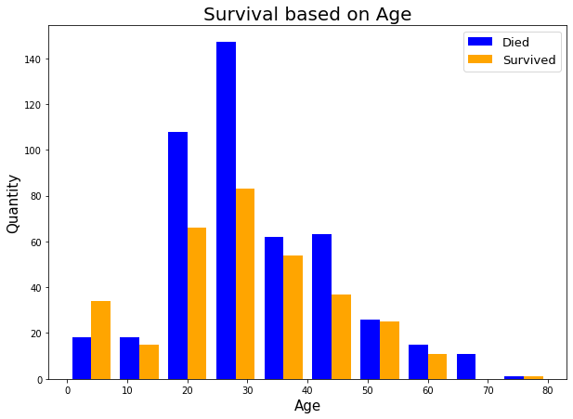
survival analysis

Slide 17
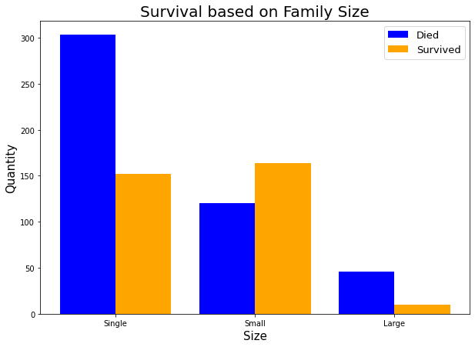
survival analysis

Slide 18
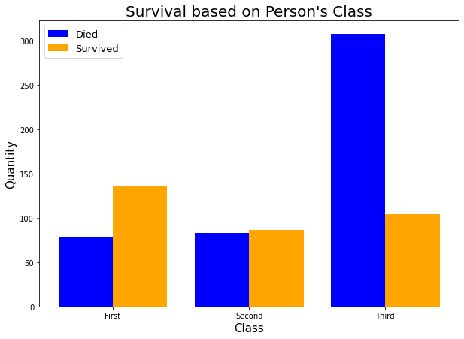
survival analysis

Slide 19
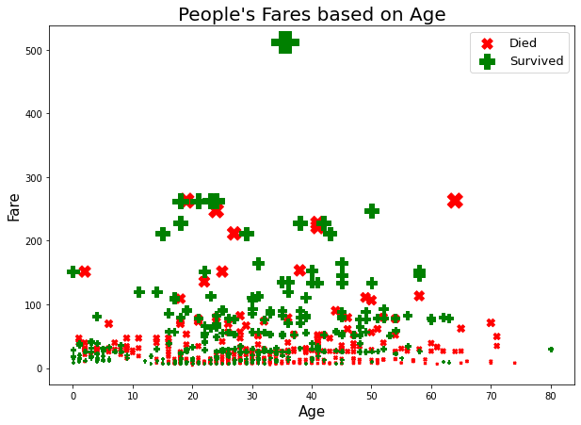
fare analysis

Slide 20
engineered features
 | Small Family | Large Family | Class
Single | No | No | 0
Small Family | Yes | No | 1
Large Family | No | Yes | 2
Ship Class | Dataset Class
First | 1
Second | 2
Third | 3

Slide 21
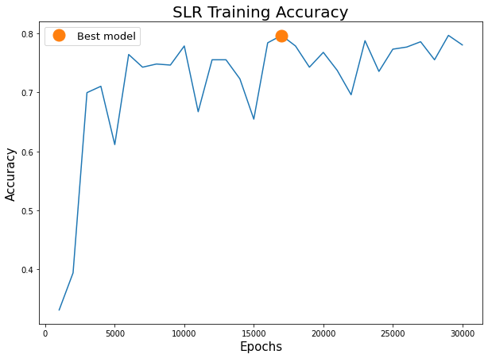
SLR model
30 different epochs
1K to 30K
Selected value: 17K
Learning rate: 0.001

Slide 22
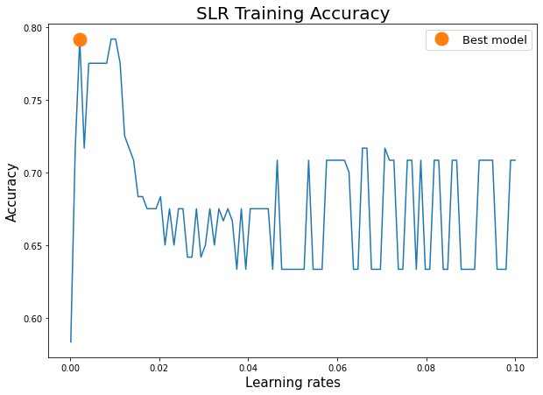
SLR model
100 different learning rates
0.0001 to 0.1
Selected value: 0.002118

Slide 23
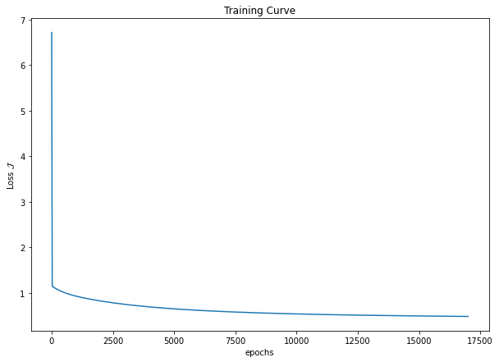
SLR model

Slide 24
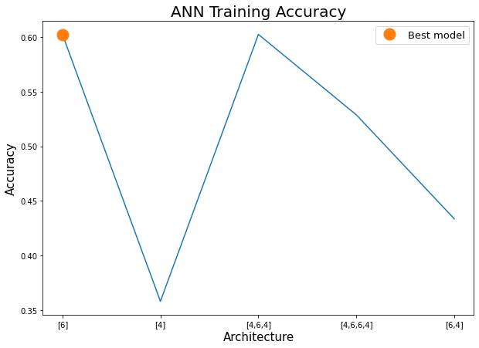
ANN FOR classification
5 different architectures
[6]
[4]
[4,6,4]
[4,6,6,4]
[6,4]
Selected model: [6]
Activation function: sigmoid
Learning rate: 0.001
Epochs: 1000

Slide 25
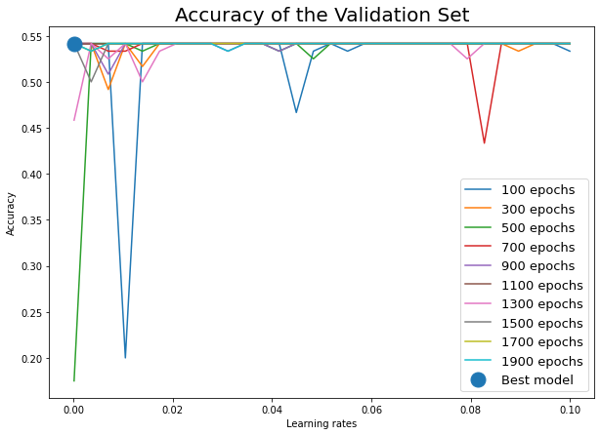
ANN FOR classification
Finetune epochs
10 values
range(100,2000,200)
Selected: 100
Finetune learning rate
30 values
From 0.0001 to 0.1
Selected: 0.0001

Slide 26
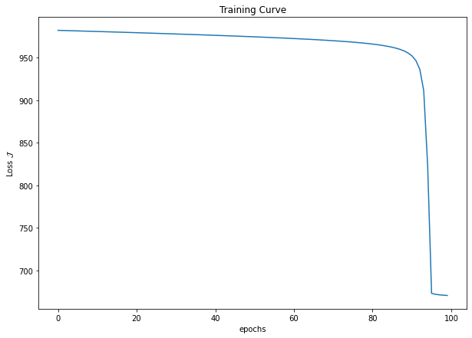
ANN FOR classification

Slide 27
Classification comparison
 | Architecture | Epochs | Learning rate | Training accuracy | Validation accuracy | Test accuracy
SLR | - | 17,000 | 0.002118 | 79.67% | 79.16% | 76.47%
ANN | [6] | 100 | 0.0001 | 60.25% | 54.16% | 57.98%

Slide 28
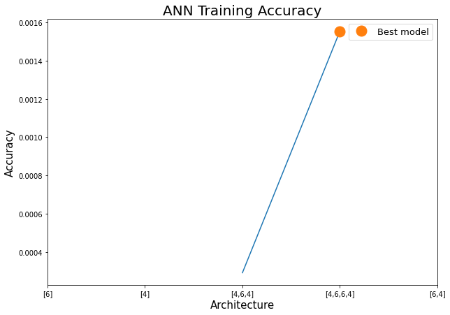
ANN FOR regression
5 different architectures
[6]
[4]
[4,6,4]
[4,6,6,4]
[6,4]
Selected model: [4,6,6,4]
Activation function: [ReLU,tanh,tanh,ReLU]
Learning rate: 0.001
Epochs: 1000

Slide 29
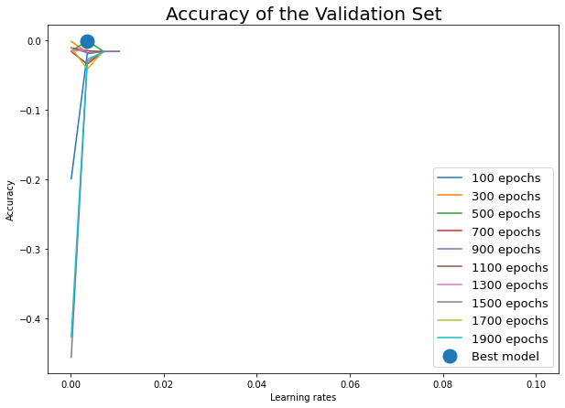
ANN FOR regression
Finetune epochs
10 values
range(100,2000,200)
Selected: 500
Finetune learning rate
30 values
From 0.0001 to 0.1
Selected: 0.0035

Slide 30
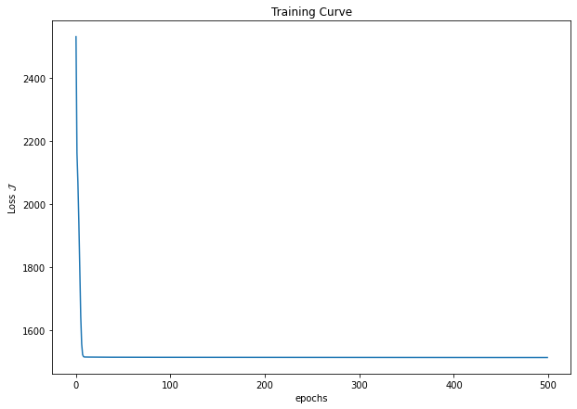
ANN FOR regression

Slide 31
regression results
 | Architecture | Epochs | Learning rate | Training R² | Validation R² | Test R²
Regression ANN | [4,6,6,4] | 500 | 0.0035 | 0.001554 | -0.00082 | -0.00386

Slide 32
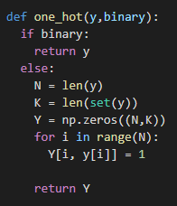
ANN class modification

Slide 33
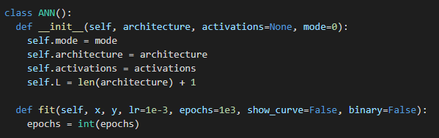
ANN class modification

Slide 34
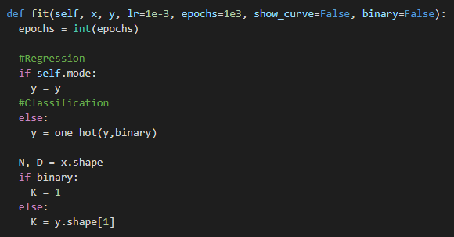
ANN class modification

Slide 35
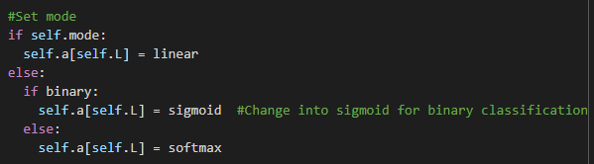
ANN class modification

Slide 36
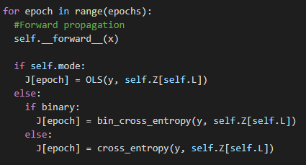
ANN class modification

Slide 37
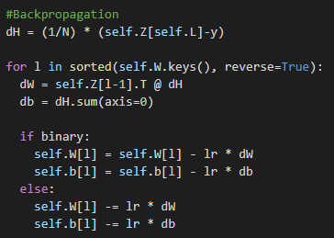
ANN class modification

